Slide 1





Exploring
Redux Middlewares
Manjot Singh

Slide 2
I am Fullstack developer, currently working as frontend developer @ collegedunia
About Me..
I Love development alot & I am not big fan of DSA.
I can talk on topic related to tech that I don't even know.

Slide 3
Lets Start Talk with
Basic Understanding of REDUX

Slide 4


UI
Dispatch Action
REDUX
Action
Redux is a predictable centralized state for JavaScript apps.
Redux state is object which can only be mutated by reducers.
Reducer
Redux is based on FLUX architecture i.e . Flux features actions which are sent through a central dispatcher to a store, and changes to the store are propagated back to the view
updated state
If changes in state, then update UI using store.subscribe()
Store

Slide 5
Let's see some
REDUX Code

Slide 6

UI
Dispatch Action
Action
Dispatch Action
Now You might be thinking
Middleware(s)
Where is Middleware ?
Reducer
If changes in state, then update UI using store.subscribe()
updated state
Store

Slide 7
Let's see some
basic implementation of REDUX Middlewares

Slide 8
1
Applications
of middlewares
Logger

Slide 9
2
Applications
of middlewares
Persisted Redux Store

Slide 10
3
Applications
of middlewares
Your own
Redux Thunk

Slide 11
Is This All about
Redux Middlewares??

Slide 12
NO

Slide 13
There's Lot more
You can also implement Advance REDUX Patterns with help of Middlewares

Slide 14
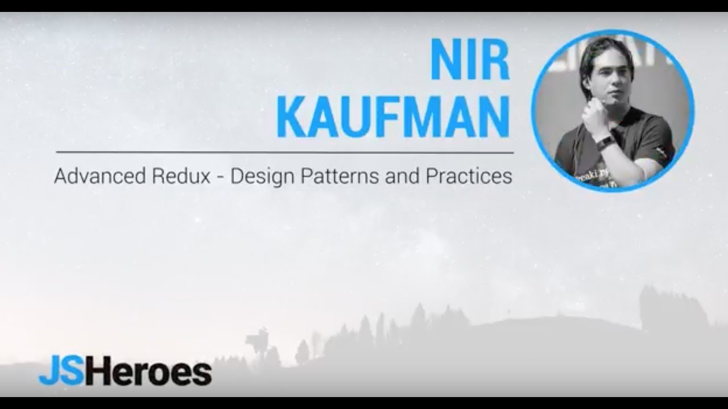
Advanced Redux: Design Patterns and Practices - Nir Kaufman | JSHeroes 2018 - YouTube

Slide 15

REFERENCES
Advanced Redux: Design Patterns and Practices - Nir Kaufman | JSHeroes 2018 - YouTube
Exploring Redux middleware (krawaller.se)

Slide 16




Connect with me
in/manjot-singh-5bb706153
/manjots1607
manjotsingh16july@gmail.com

